Slide 1

Multichannel Retail Store Analysis

Slide 2
Table of contents
01.
Context
02.
Dataset
03.
Analysis
04.
Insights
Company description and problem statement
Description of the data being worked on
How data was used to approach the problems
How the analysis can lead to business decisions

Slide 3


01.
Context
Company description and problem statement

Slide 4



Company
Size
Reputation
Product
Successful and established multichannel retail company with stores nationwide
Well known and has a strong positive reputation, with great long term loyalty
Sells many different products, but mostly food products purchased as gifts during Christmas

Slide 5
Marketing Problems
01.
02.
03.
Customer relationship management, including contact management, across multiple channels
A very competitive marketplace for Christmas season gifts
Generating business during the non-Christmas months of the year

Slide 6
Questions We Focused On
1. What channel should strategic development be focused on to maximize growth?
2. Do customer segments correlate to a channel?
3. Do different customer groups behave differently from a price perspective? How should we promote accordingly to generate more sales?

Slide 7
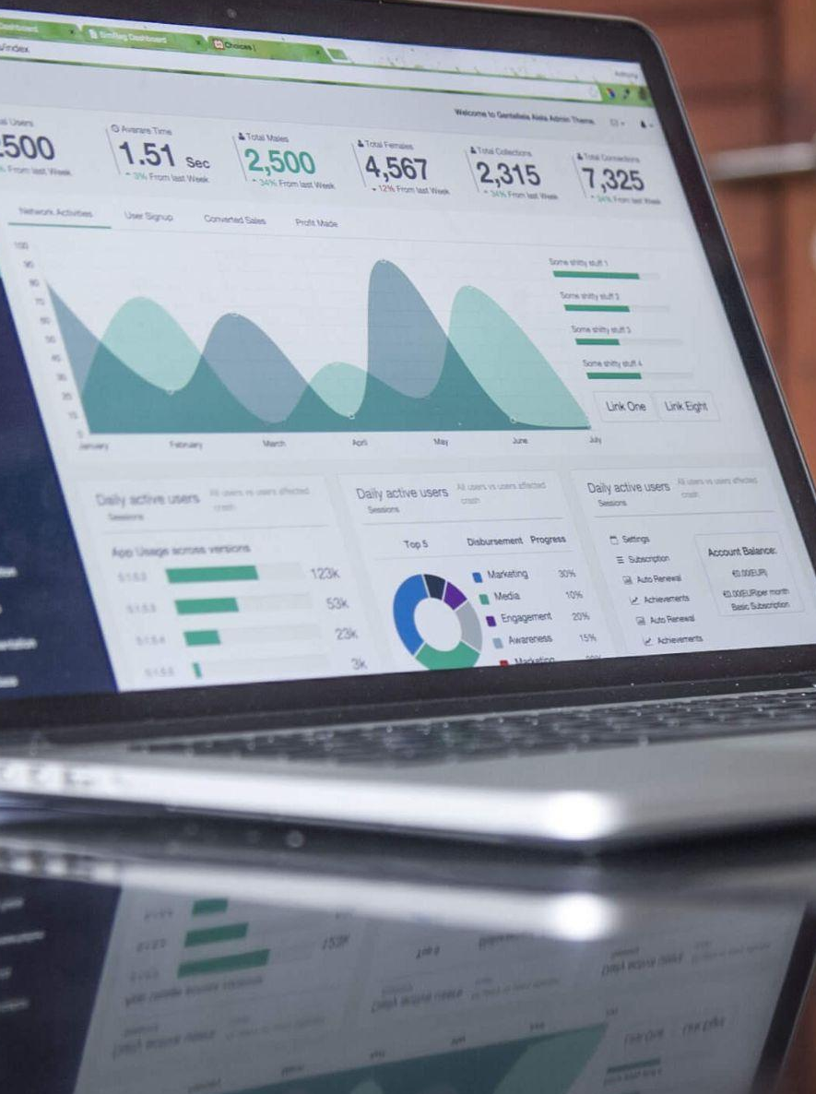
02.
Dataset
Description of the data being worked on

Slide 8
Description of Data
DMEFExtractSummaryV01 - Summary File
100,051 records, 200 variables
Customer buying activity, demographic, psychographic and distance to retail store
Data summarized by channel & season
DMEFExtractContactsV01 - Marketing contact records
3,389,329 records, 3 variables
Customer ID, Contact Date, and Form of Contact
Records across years 2005-2007
DMEFExtractLinesV01 - Line item records
618,661 records, 6 variables
Customer ID, Order ID, Date, Price, Gift (Y or N), and Gift Recipient ID
Records across years 2001-2007
DMEFExtractOrders - Order or store trip records
241,366 records, 5 variables
Customer ID, Order ID, Date, Channel, and Payment Method
Records across years 2001-2007

Slide 9
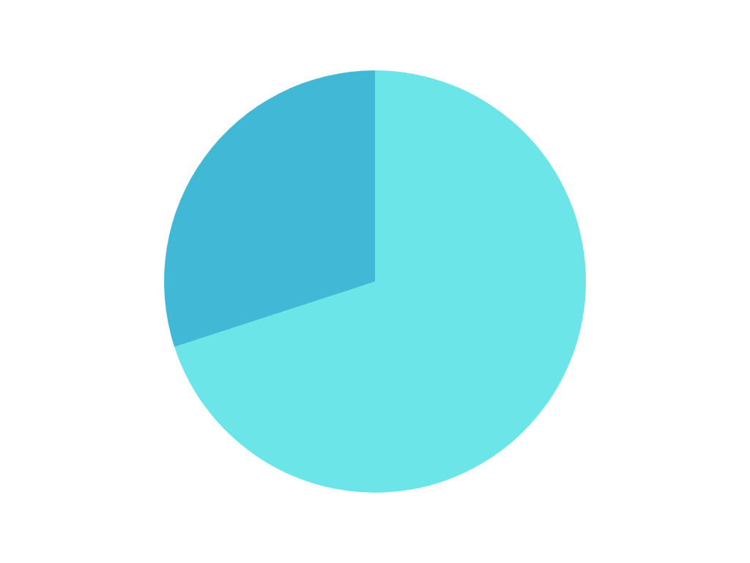

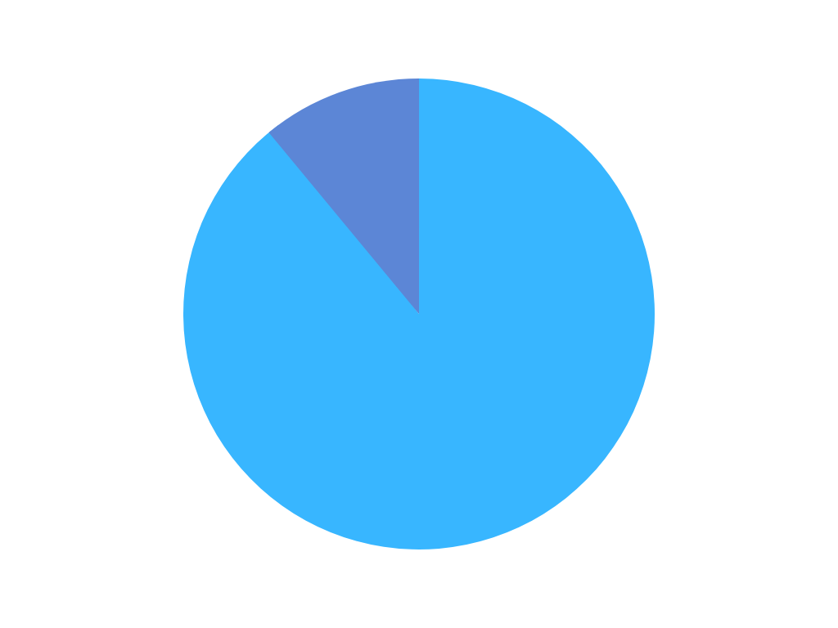
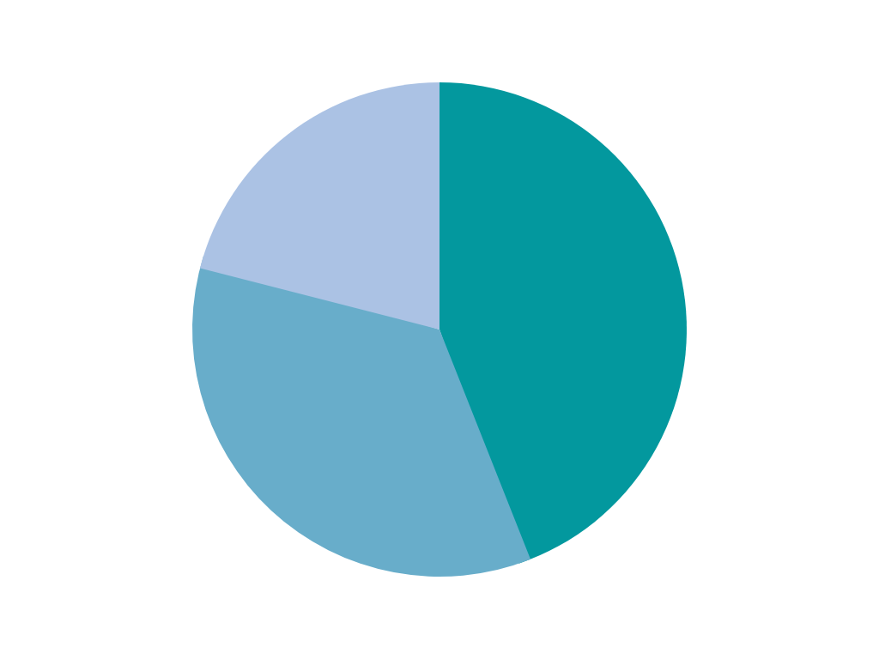
Exploratory Analysis
30%
Catalog
Avg distance to a store:
45 miles for all customers
38 miles for retail customers
Customer Contact method
70%
Email
11%
Non-Gifts
22%
Internet
Gifting Percentage
Purchase Channel Percentages
44%
Retail
89%
Gifts
35%
Catalog

Slide 10

03.
Analysis
How data was used to approach the problems

Slide 11
Analysis One
Customer Segmentation based on their first purchase

Slide 12
Segmentation by First Purchase Channel
Type of Model:
Multivariable Logistic Regression
Data split based on FirstChannel (Retail = 1, Catalog = 2, Internet = 3)
Dependent Variable
First Channel
Independent Variables
Store Distance
Age
First Month of Contact
Income Level
Email
Data Transformations:
Transformed Age, Income Level, and First Month to binary variables
NAs ommitted

Slide 13
Understanding Customer’s First Purchase
We can learn how to market to these customers based on the customer’s first purchase
Independent variable impact on the dependent variables
Store Distance
Further distance away, more likely to order via catalog
We can reduce costs by sending catalogs to only those who live far away
Provide special coupons inside catalog
Shorter distance away, more likely to go inside store
We can offer store coupons to people who live close by
We can advertise in nearby billboards
Age
18 - 34 and 45 - 74 years olds are more likely to shop at a retail store
35 - 44 year olds are more likely to shop on the internet
75+ year olds had no effect on the independent variable

Slide 14
Understanding Customer’s First Purchase (cont)
Month of First Purchase
The most effective month for internet purchases is August
July and October are solid months for retail purchases
The are no good months for catalog purchases
Marketing efforts should be made a few weeks before the strong months
Income
Incomes below $30k and above $50k are likely to make their first purchase at a retail store
Incomes between $30k - $50k are more likely to make their first purchase online
Discounts can be adjusted accordingly based on the market
Email
Retail shoppers are less likely to have an email
We can offer discounts via store flyers to these customers

Slide 15
Analysis Two
Customer Purchase Behavior Exploration - Price

Slide 16
Why?
How?
Analyzing customer purchase behavior from a price perspective helps to understand their life-style, their affordability, and their price sensitivity, hence it impacts how pricing and promotion strategies should be made - in our case, it is important for the marketing strategy of generating more sales.
Understand different customer groups’ price range based on their shared features, such as do people buy more expensive things when they don’t have kids, do people choose more expensive things when their income levels are higher? Some are intuitive, yet worth to check with data.

Slide 17
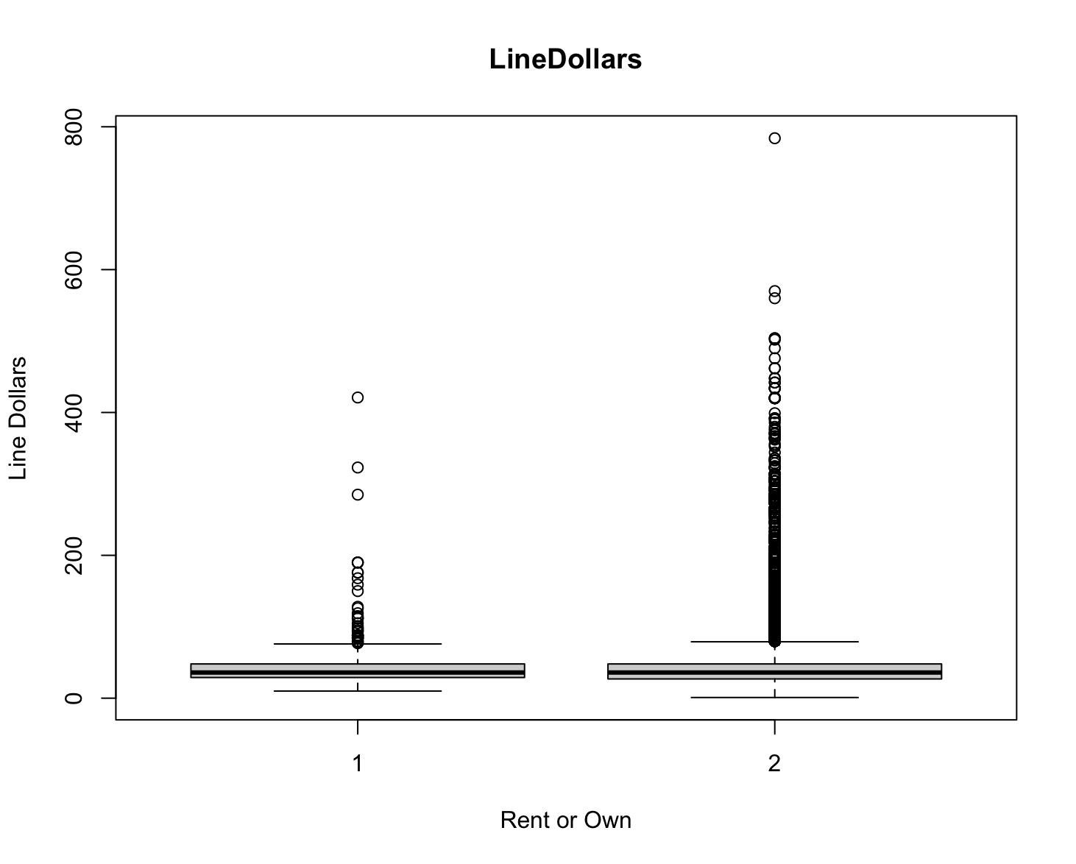
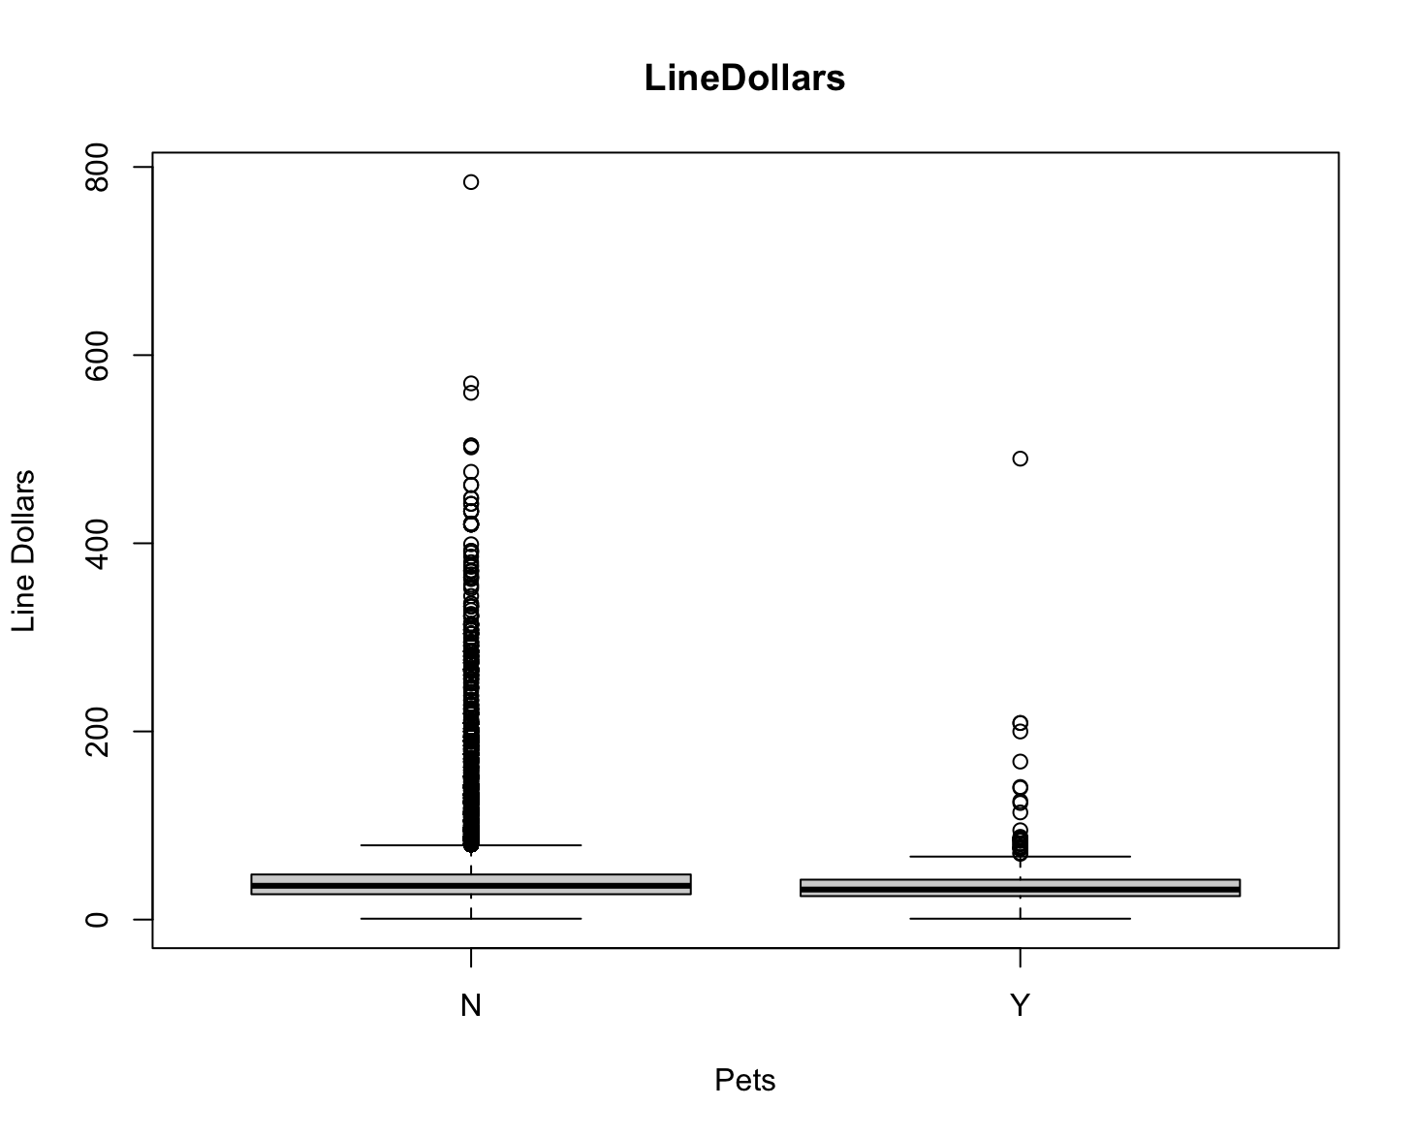
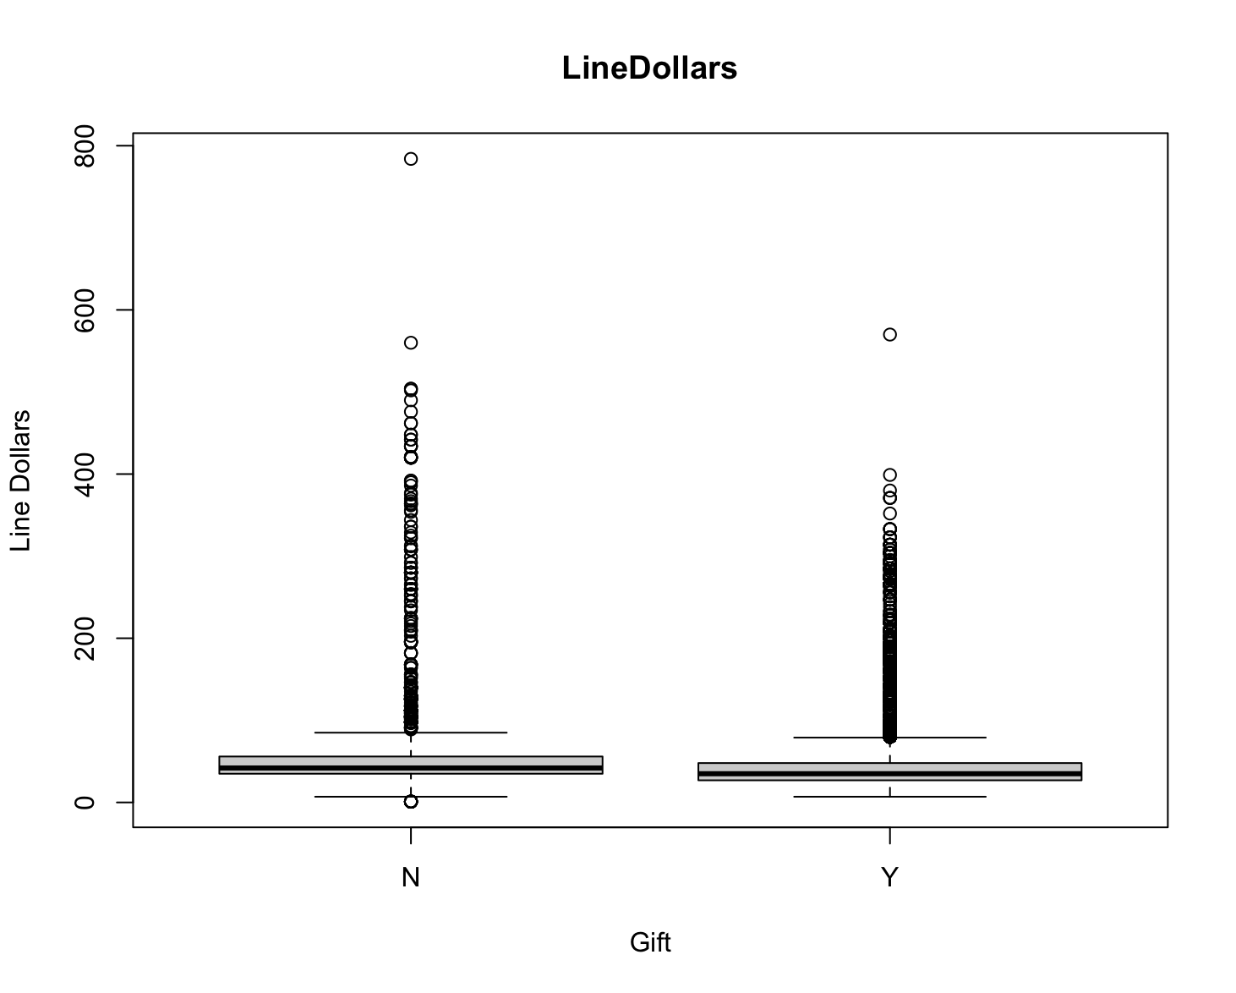
Findings
Renters vs. Owners
Pets vs. No-Pets
Gift vs. No-Gift
House Owners are buying more expensive things;
Non-Pets Owners are buying more expensive things;
People spent slightly less money on gift items than self-consume items.

Slide 18
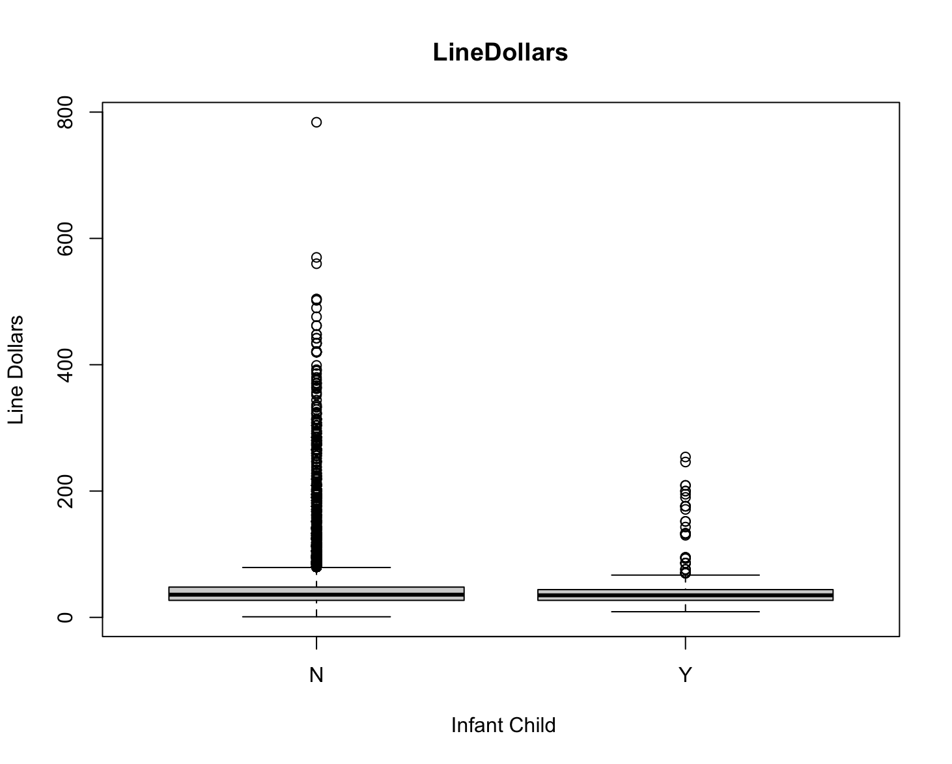
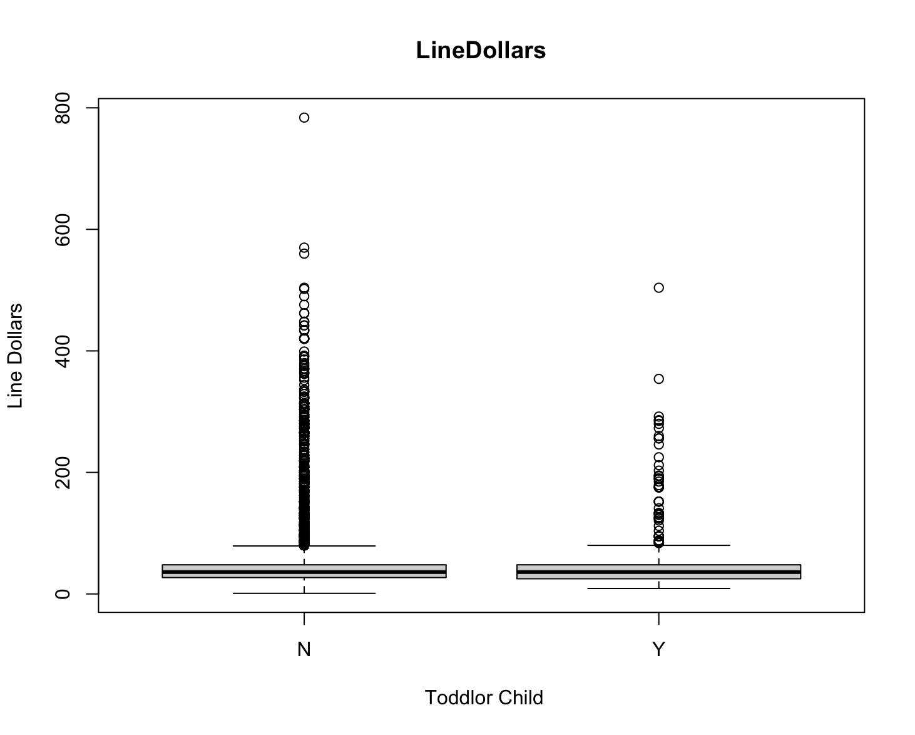
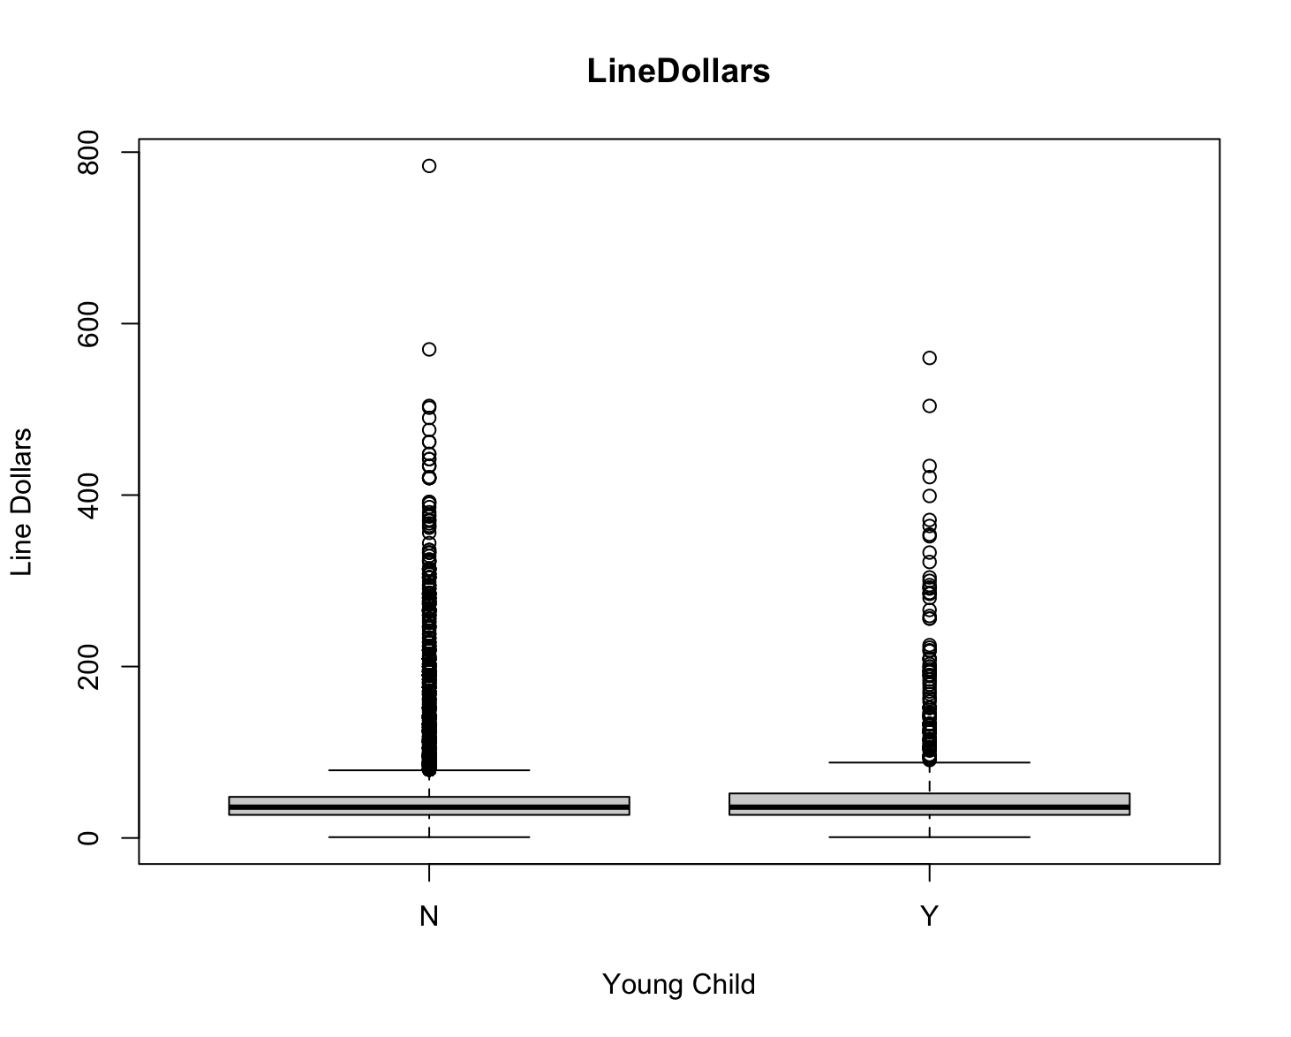


Findings - Does Children Impact Price Range?
Infant vs. No
Toddler vs. No
Young vs. No-Young
ANSWER: YES!

Slide 19
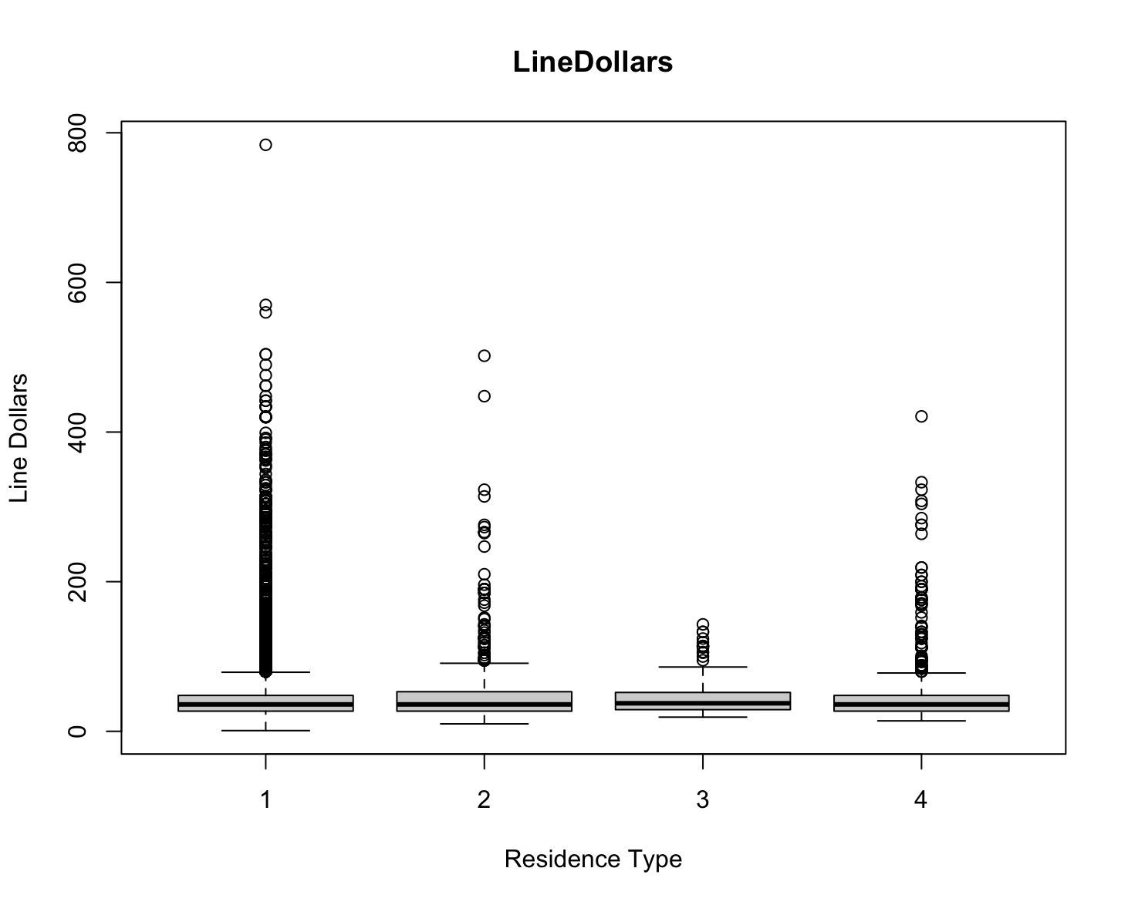
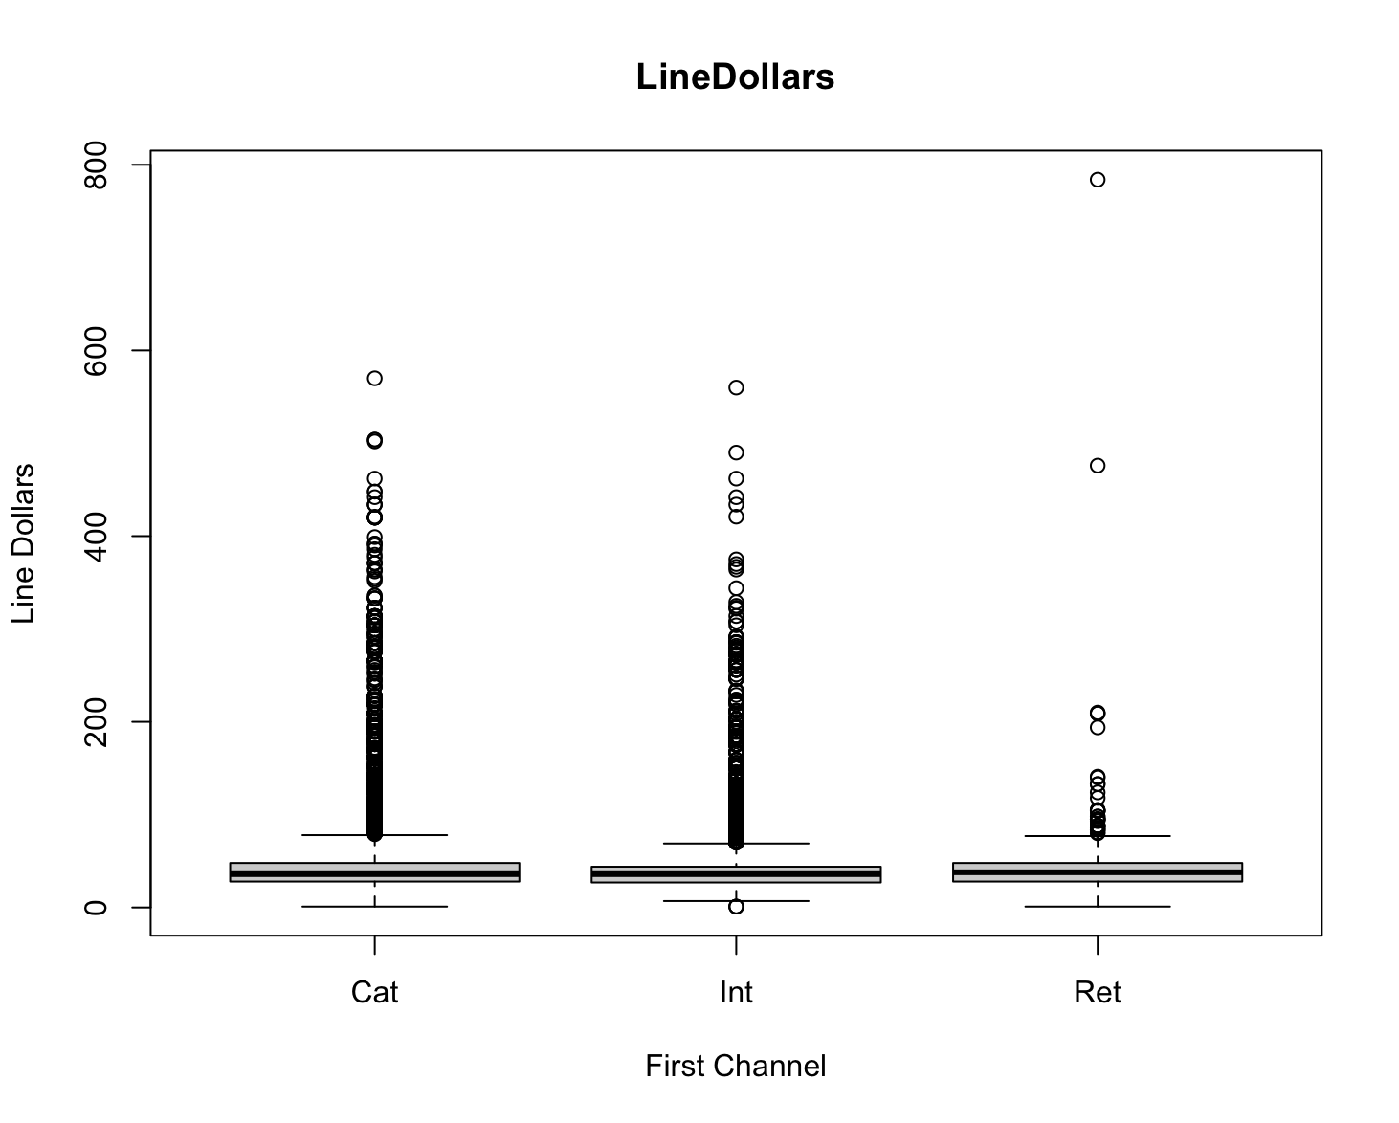
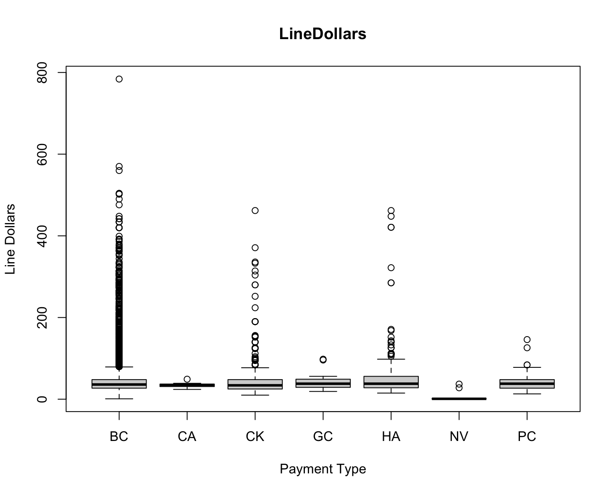
Findings - Others
Residence Type
First Channel
Payment Type
People who live in single family houses buy more expensive things, people who live in multi-dwelling residences buy relatively low price items
Catalog and Internet buyers purchase more expensive items, retail buyers favor relatively lower price items;
People who have bank cards buy more expensive items

Slide 20
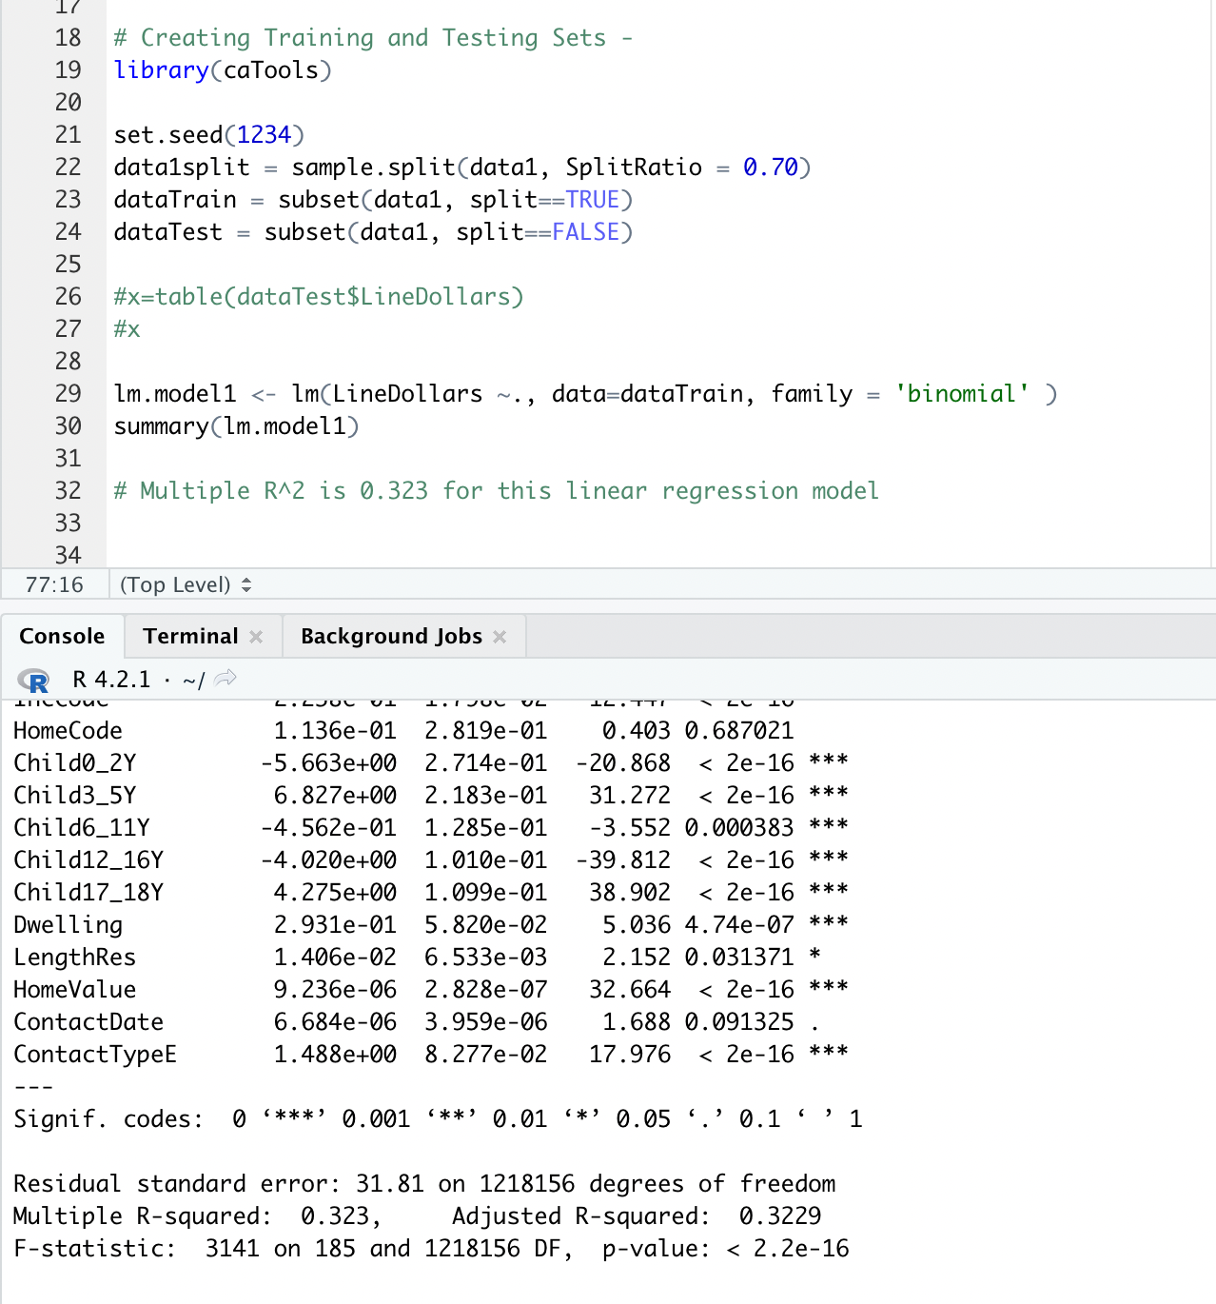
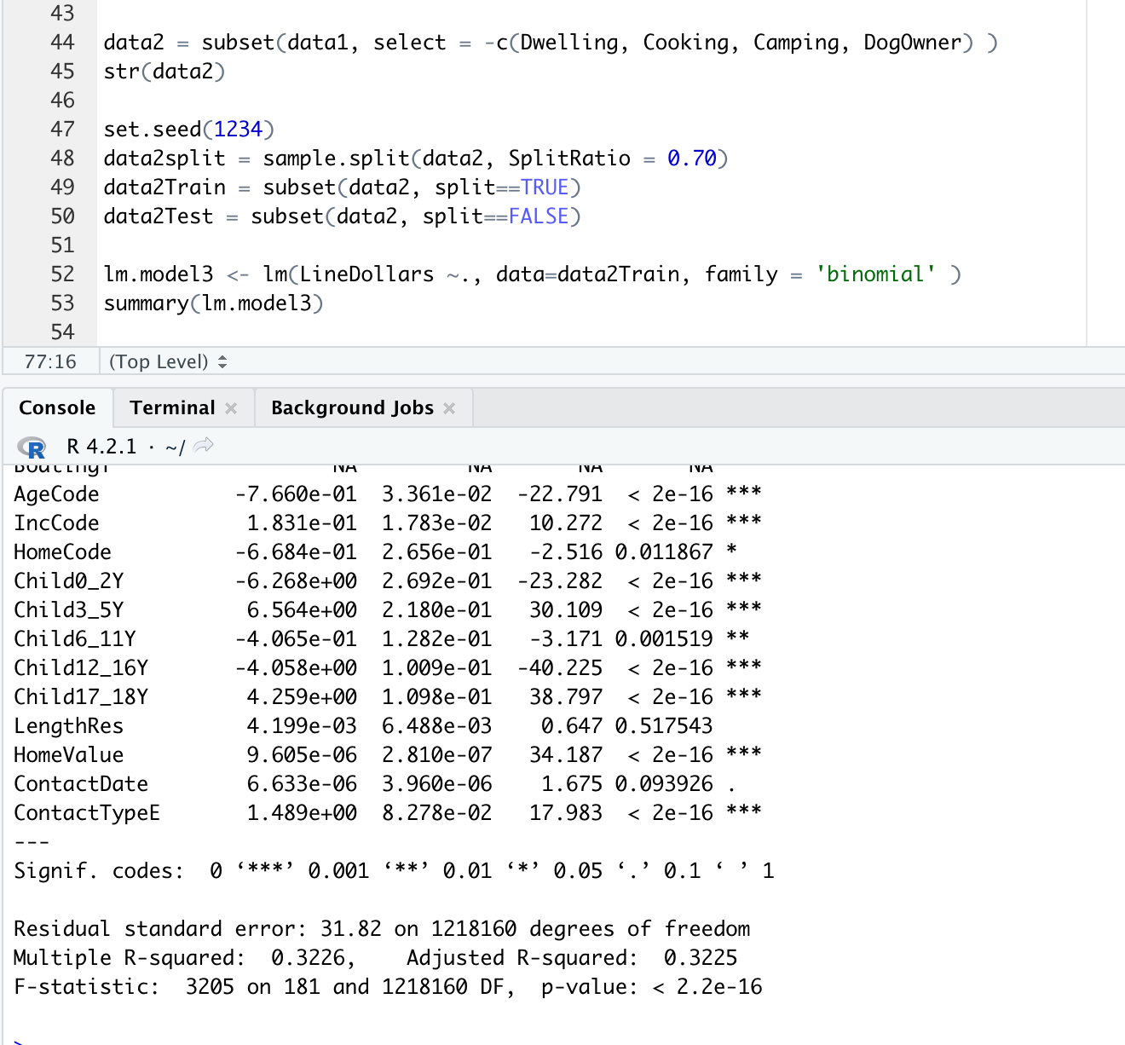
Predict price range based on people’s behavior
First Trail - R^2: 0.323
Second Trail - R^2: 0.3226

Slide 21
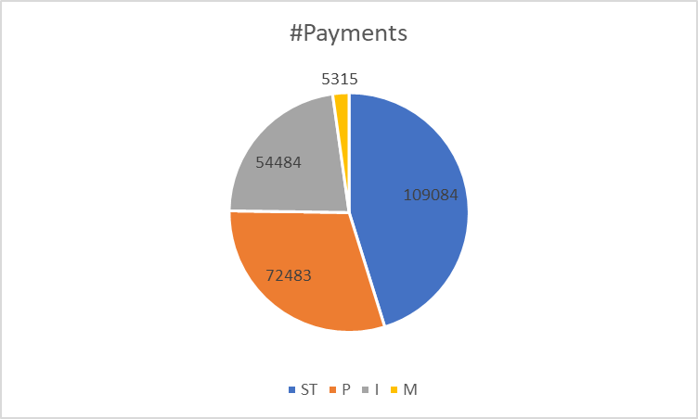
Findings - Customer Purchase Behavior
ST = Store, I= Internet,
P = Phone, M = Mail
Highest Purchases have been made through the store, and least via Mail
Purchases over Phone is slightly higher than Internet. Hence, try to attract through promotional offers via phone

Slide 22
04.
Insights
How the analysis can lead to business decisions

Slide 23
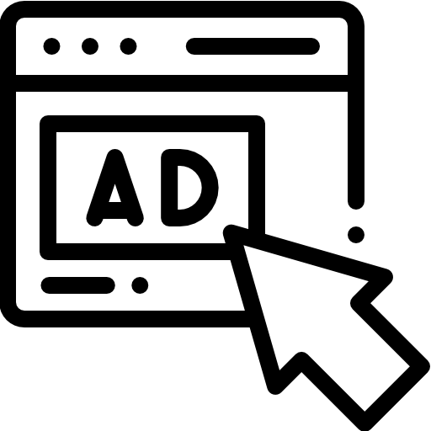

Further Analysis (lack of data)
Data we wish we had:
Advertising Costs to build advertising response rate model and allocate budget accordingly
Item Purchased to see which are the best-selling items during Christmas time and advertise accordingly, forecast demand
Returns Data to predict how many returns we expect to have after Christmas

Slide 24




Recommendations
The further away from a retail store or if middle-aged professional, the more likely the customer will order from the internet. Online marketing/advertising should be made on areas where there isn’t a nearby retail store and where the market is mostly comprised of families.
Based on people’s spending price range, for the renters, pet’s owners, people who have children, people who are living in multiple-residence buildings, regularly sending coupons might help them to spend more
Since people who live in single family houses end up buying expensive things compared to the rest, they should be specially targeted to boost sales
Since majority of the items bought are gifts and having children does impact the behavior of buying, more products should be promoted as gifting items

Slide 25
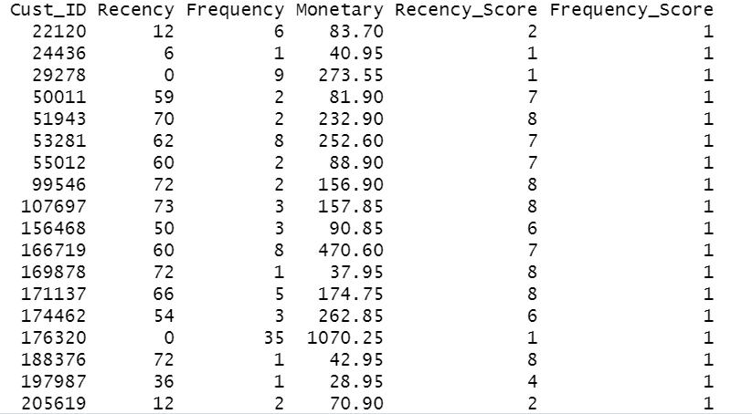
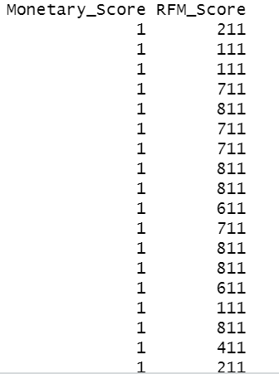
RFM Analysis

Slide 26



In Summary,
Target
Promote
Incentivize
Our analysis resulted in specific people to market towards, reducing company spending and increasing sales
We will advertise, promote, and focus more on certain products during specific seasons, based on our analysis
Some customers will receive incentives like coupons or discounts via their preferred channel to continue shopping with us

Slide 27
Thanks!
We would be happy to answer your questions.

Slide 28

05.
Appendix

Slide 29
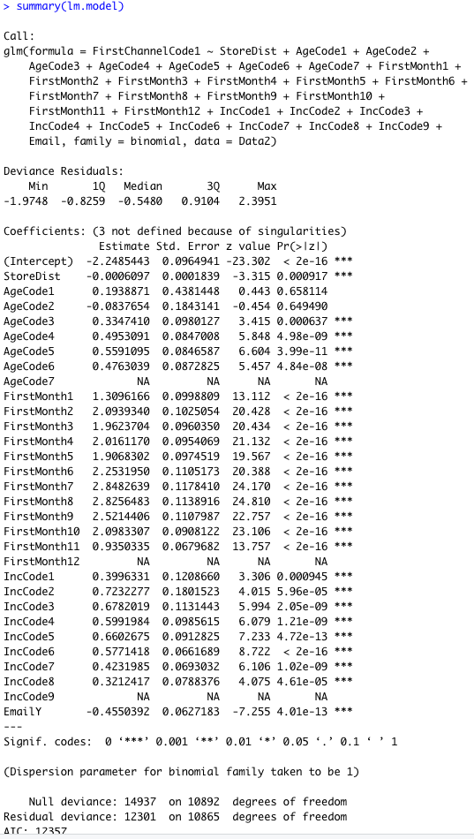
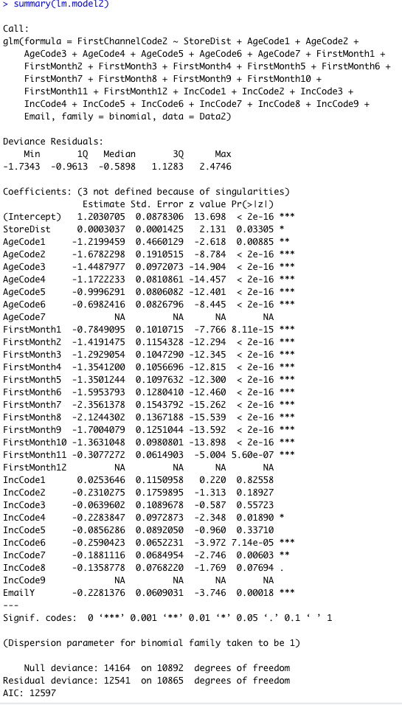
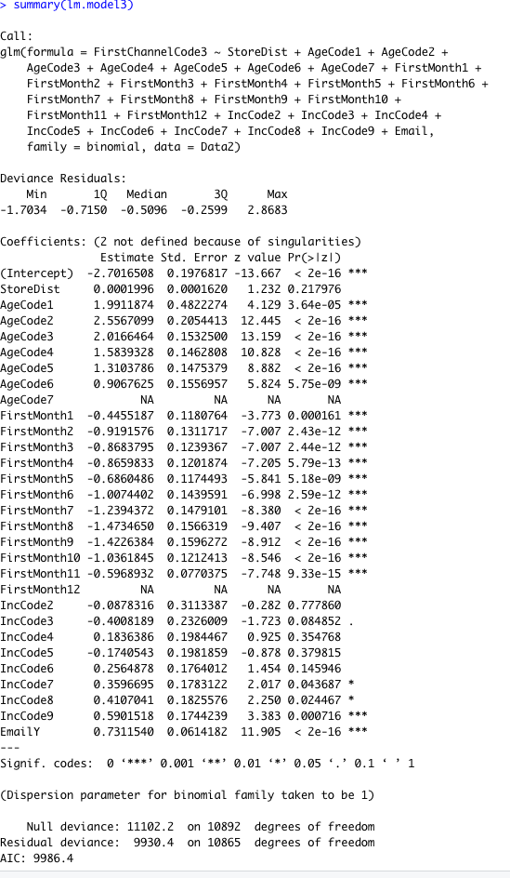
Multivariable Logistic Regression
Retail
Catalogue
Internet

